Slide 1
Part I
Plots by Replicates

Slide 2
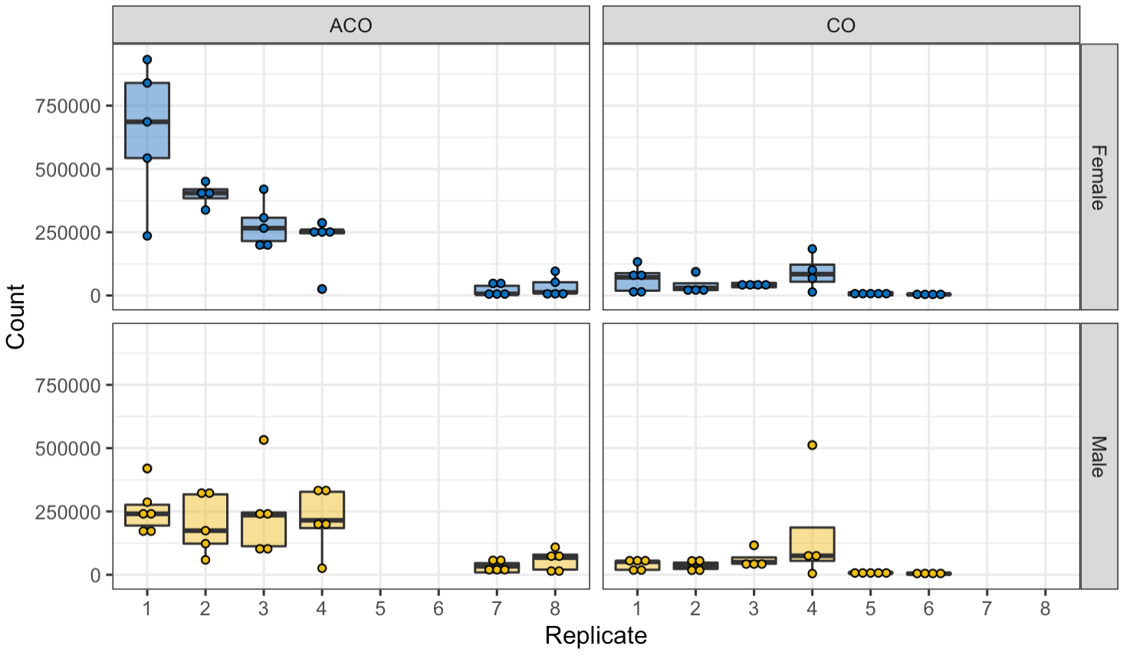
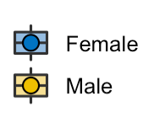
Raw Data Plot – Proteobacteria

Slide 3
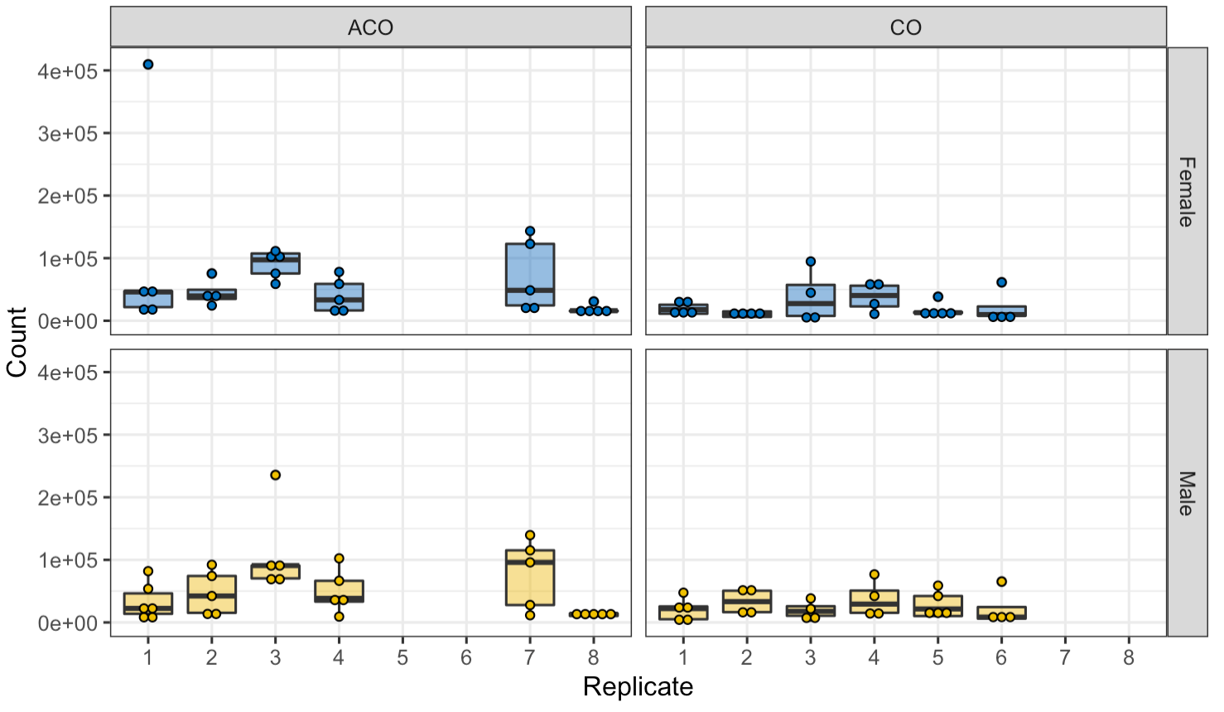
Raw Data Plot – Firmicutes

Slide 4
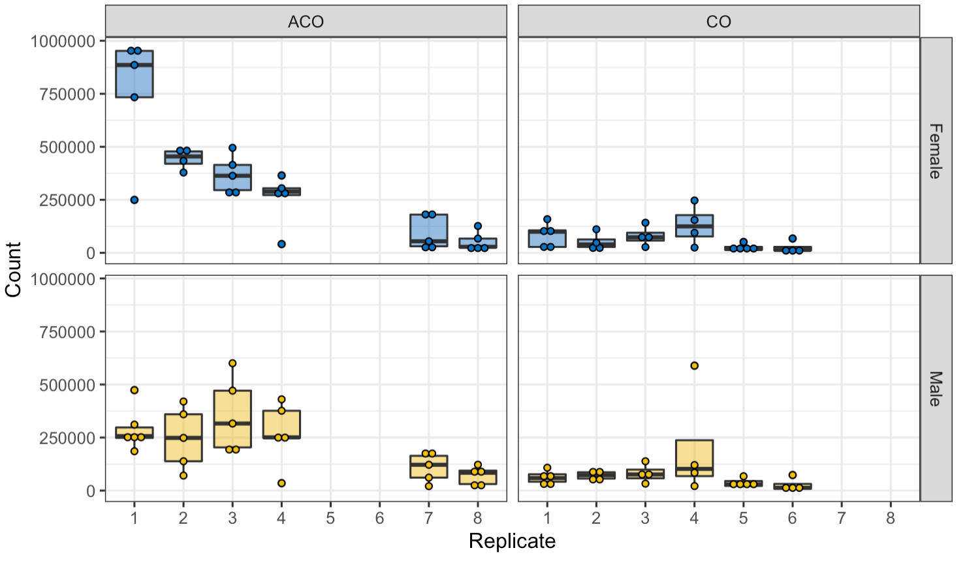
Raw Data Plot – Total

Slide 5
Part II
Preliminary Analysis

Slide 6
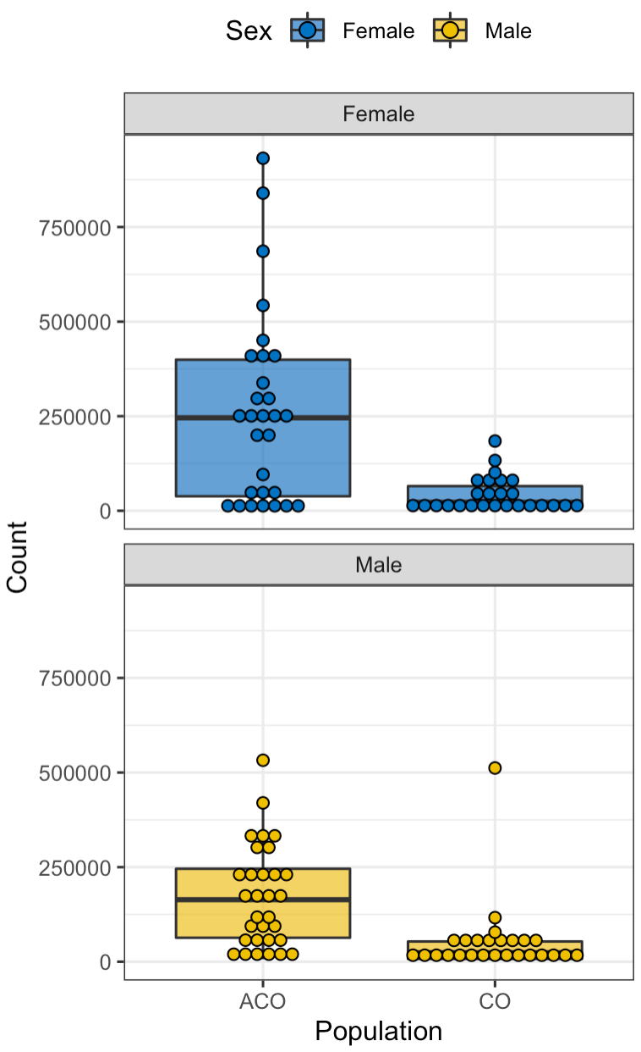
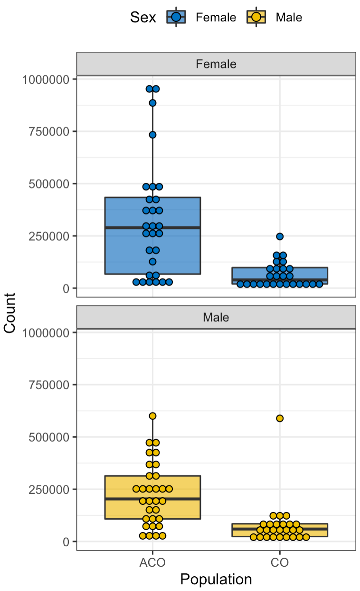
Raw Data Plots
Proteobacteria
Firmicutes
Total

Slide 7
Raw Data Statistics Summary
Group | Size | Mean | Median | Standard Deviation
ACO Female | 29 | 261,412 | 245,760 | 251,424
CO Female | 26 | 41,262 | 22,400 | 46,669
ACO Male | 31 | 170,658 | 163,840 | 134,429
CO Male | 26 | 50,695 | 23,840 | 98,734
Proteobacteria
Group | Size | Mean | Median | Standard Deviation
ACO Female | 29 | 62,750 | 40,960 | 76,217
CO Female | 26 | 23,723 | 13,520 | 22,912
ACO Male | 31 | 54,612 | 38,400 | 50,772
CO Male | 26 | 26,608 | 19,120 | 21,405
Firmicutes
Group | Size | Mean | Median | Standard Deviation
ACO Female | 29 | 324,162 | 289,280 | 276,457
CO Female | 26 | 64,985 | 39,680 | 59,837
ACO Male | 31 | 225,270 | 203,520 | 151,405
CO Male | 26 | 77,304 | 59,600 | 110,163
Total

Slide 8
Part II
Negative Binomial Regression
on Count Data

Slide 9
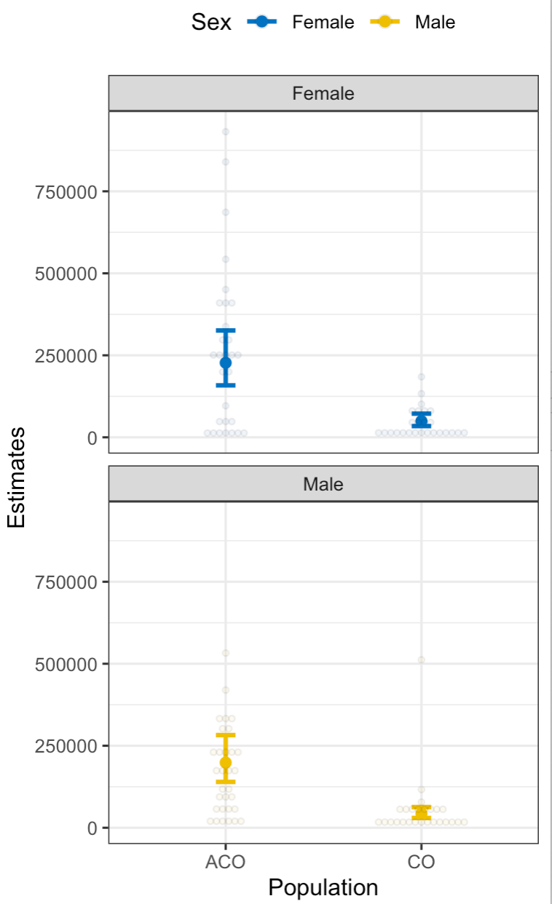
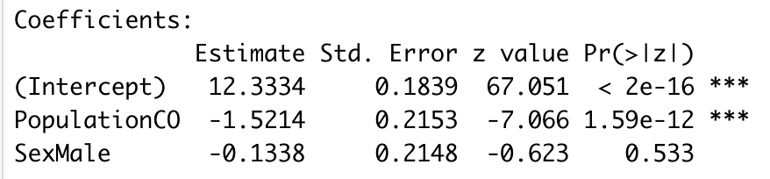
NB Reg. – Proteobacteria
Model Summary
Population_CO = -1.5214 → Population CO is expected to have exp(-1.5214) = 21.84% time as many Proteobacteria as Population ACO on average. (OR, ACO has more Proteobacteria then CO).
Sex_Male: No significant difference between Male and Female.

Slide 10
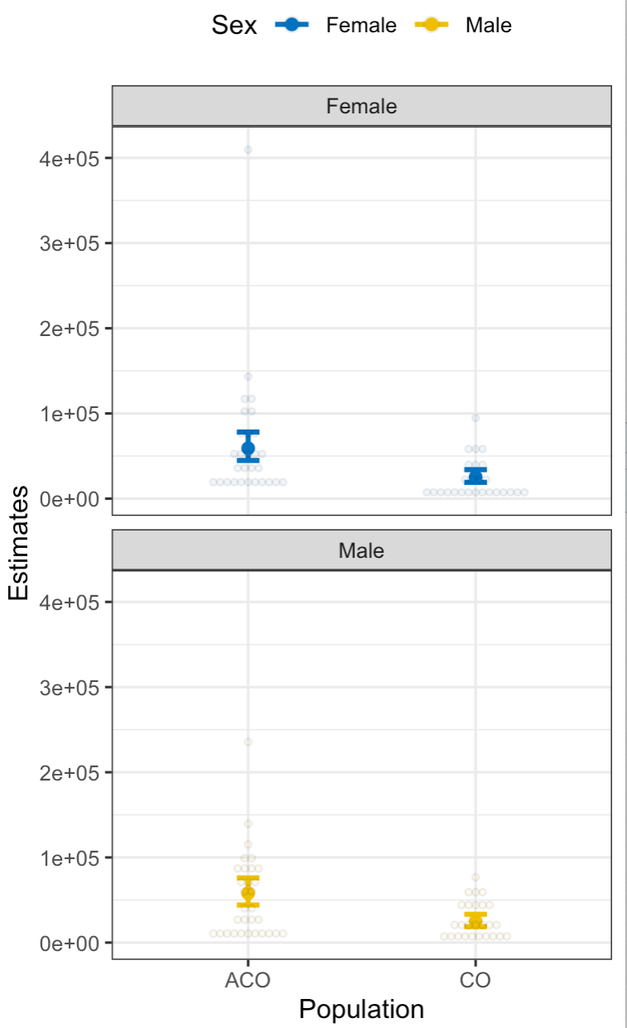
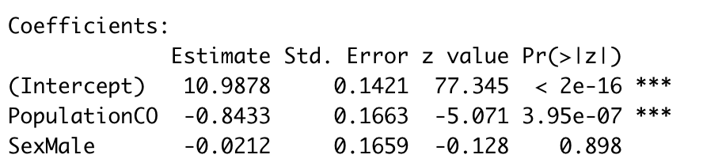
NB Reg. – Firmicutes
Model Summary
Population_CO = -0.8433 → Population CO is expected to have exp(-0.8433) = 43.03% time as many Proteobacteria as Population ACO on average. (OR, ACO has more Proteobacteria then CO).
Sex_Male: No significant difference between Male and Female.

Slide 11
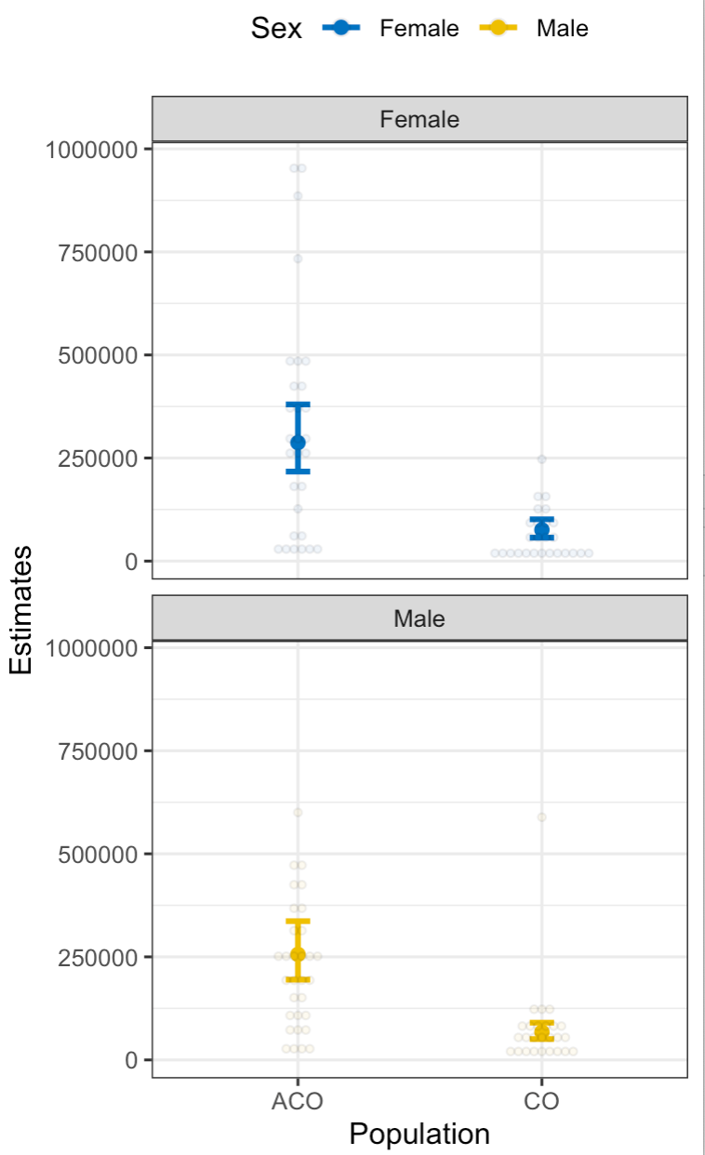
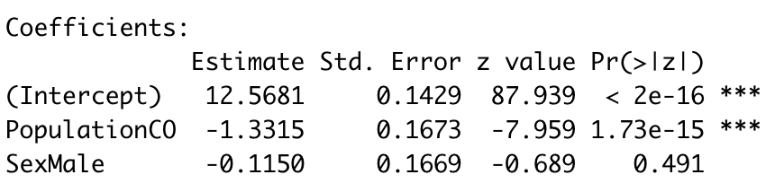
NB Reg. – Total
Model Summary
Population_CO = -1.3315 → Population CO is expected to have exp(-1.3315) = 26.41% time as many Proteobacteria as Population ACO on average. (OR, ACO has more Proteobacteria then CO).
Sex_Male: No significant difference between Male and Female.

